Slide 1

FACE RECOGNITION BASED ATTENDANCE SYSTEM
A Presentation on:-
Presented by:-
Sagar Kumar Chaubey

Slide 2
TABLE OF
CONTENT
INTRODUCTION
SIGNIFICANCE
REQUIREMENTS
OVERVIEW
FEATURES
CONCLUSION
FUTURE SCOPE

Slide 3
INTRODUCTION
Every college require an attendance system to maintain record of present students.
Face Recognition Attendance System is developed for the Faculty to maintain and record attendance.
It uses facial recognition technology to identify the person’s facial features and automatically mark attendance which is comparatively very fast than old methods.

Slide 4
SIGNIFICANCE
Simple & Automatic
Easy Record Manage
Save Time & Efforts
Efficiency & Capability

Slide 5
REQUIREMENTS
HARDWARE
SOFTWARE
Computer (i3,4gb)+
Camera
Hard Disk- 500mb+
Windows 10+
Python 3.8 MySQL
Visual Studio Code

Slide 6
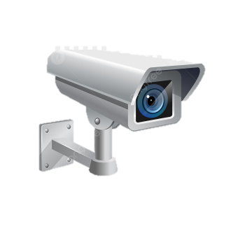


BASIC STRUCTURE
The camera detect all students and marks the attendance.

Slide 7
IMAGE PROCESSING
2. Convert to grayscale and recognize the faces.
1. Capture Image
Database
3. Match with dataset in database
4. Mark attendance.

Slide 8
FACE RECOGNITION BASED ATTENDANCE SYSTEM
STUDENT MANAGEMENT
ATTENDANCE MANAGEMENT
MARK ATTENDANCE
STUDENT DETAILS
MANAGE
PRESENT/ ABSENT
IMPORT
TAKE PHOTO SAMPLE
EXPORT
PROCESS IMAGES
OUR TEAM DETAILS
CREATE CLASSIFIER.XML

Slide 9
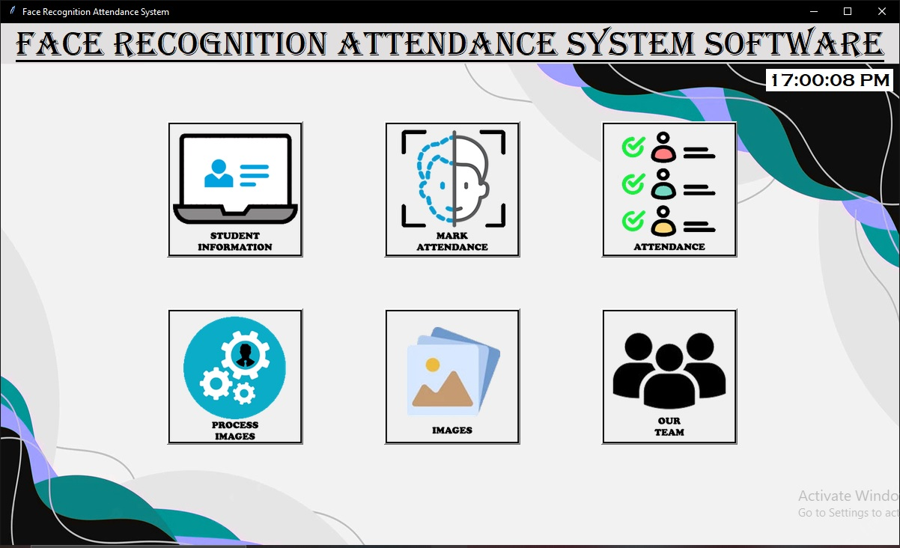
Manage student data and create dataset.
Open camera and mark attendance.
Attendance management
Show Developer details
Train dataset classifier
Open dataset directory

Slide 10
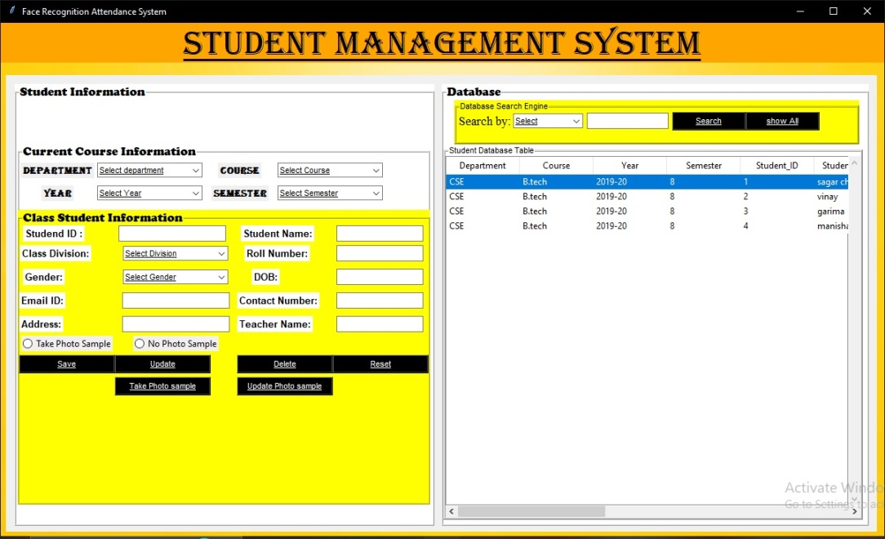
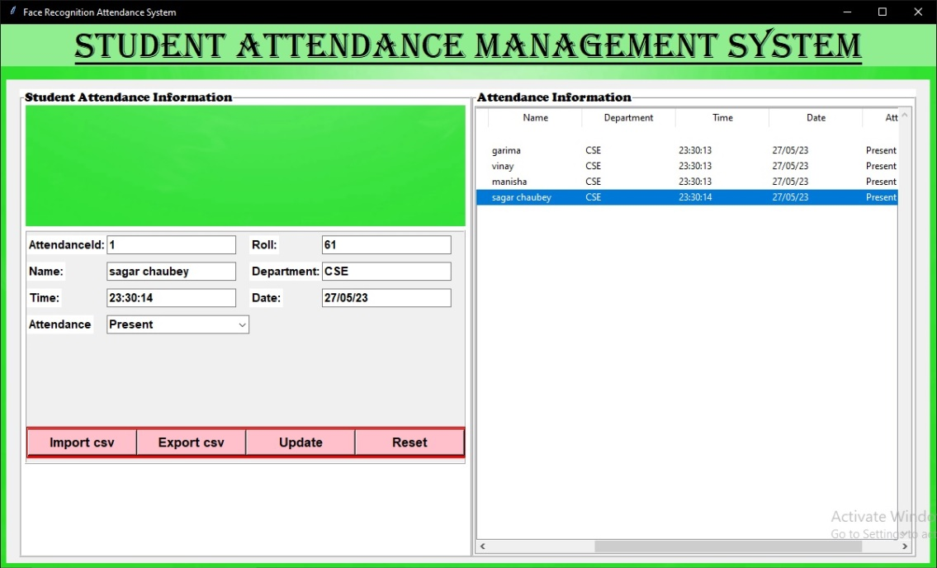
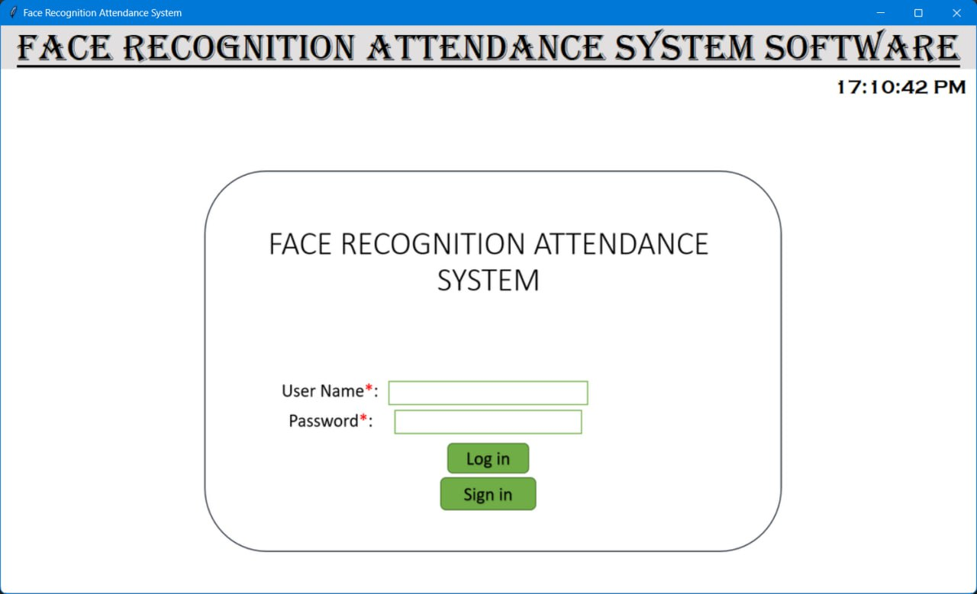
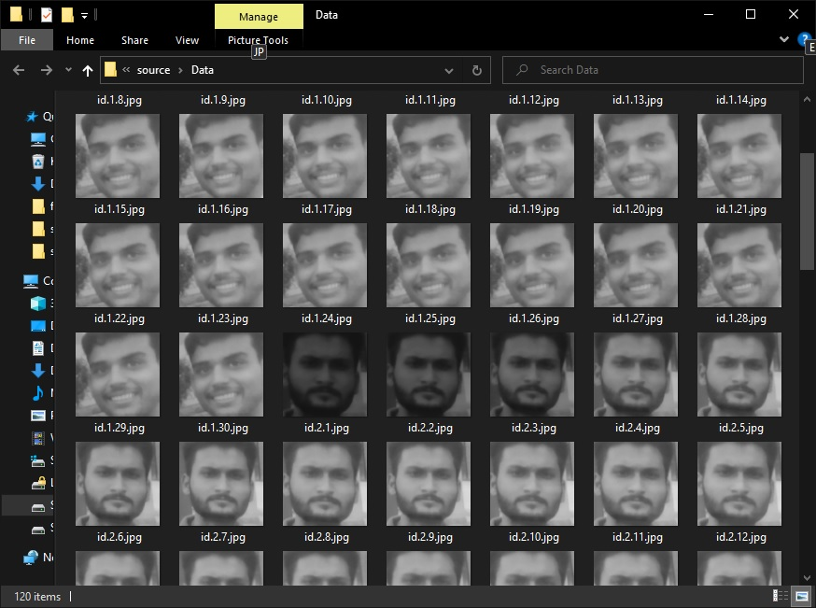
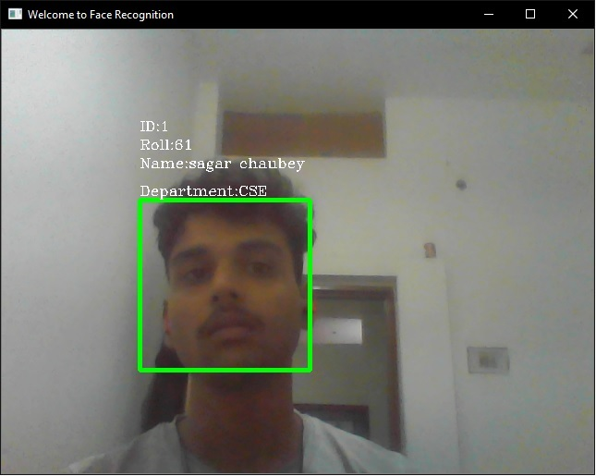
FEATURES

Slide 11
CONCLUSION
The facial recognition based attendance system is secure, reliable, an automated and accurate solution for attendance management.
It saves time and lot of effort, especially if it is a lecture with huge number of students.
And it reduces the attendance mistakes and frauds.

Slide 12
FUTURE SCOPE
Some of the future enhancements in facial recognition based attendance system are as follows:
Notifying students about their attendance through a student portal.
Maximizing accuracy with addition of powerful algorithms for face recognition.

Slide 13
THANK YOU

